Slide 1
Neural Network Assisted Temporal Reduction for Transmission Expansion Planning

Slide 2
Overview
Problem setting + motivation
Methodology
Process overview
Optimization problem
Neural network
Line benefits
Clustering process
Results thus far
Neural network output
Line benefits
Future tasks

Slide 3
Background: transmission expansion planning
TEP is based on calculating the demanding OPF problem
Increasing share of renewables → Rising variability in system operation
Temporal reduction techniques → Representative periods
Capture variability in system operating conditions (weather)
Accurately represent physical constraints of network
Many demanding OPFS
Computational tractability
Temporal reduction
Representative periods

Slide 4
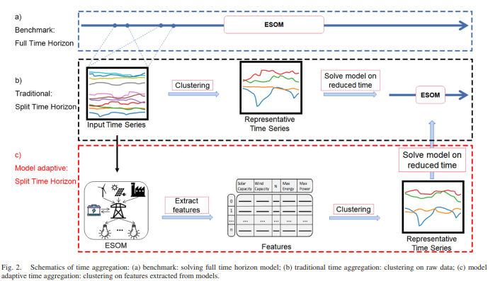
Motivation: finding representative periods
How to find representative periods for a spatially resolved system with complex interactions?
→ Ex-post clustering = use simplified model to extract features relevant for your problem and cluster on those

Slide 5
Motivation: finding representative periods
Proposed feature for clustering for TEP: Investment benefit of individual lines
Many possible candidates
Many discrete values for expansion
Weather year sensitivity
A multitude of OPFs to be solved
Replace part of the calculation with a machine-learning algorithm

Slide 6
Process overview
Benchmark:
Full time horizon
Input Data
ESOM
Traditional:
Split time horizon
Input Time Series
Clustering
Method
Representative Time Series
ESOM
Relaxed ESOM
Features
Clustering
Method
Representative Time Series
ESOM
Based in Costs:
Split time horizon
(ANN + Kmedoids)
Clustering
Method
Investment Benefit
Proposal:
Split time horizon
ANN: Cost Estimator
Features
(Investment benefit)
Representative Time Series
ESOM
*ESOM: Energy System Optimization Model
**ANN: Artificial Neural Network

Slide 7
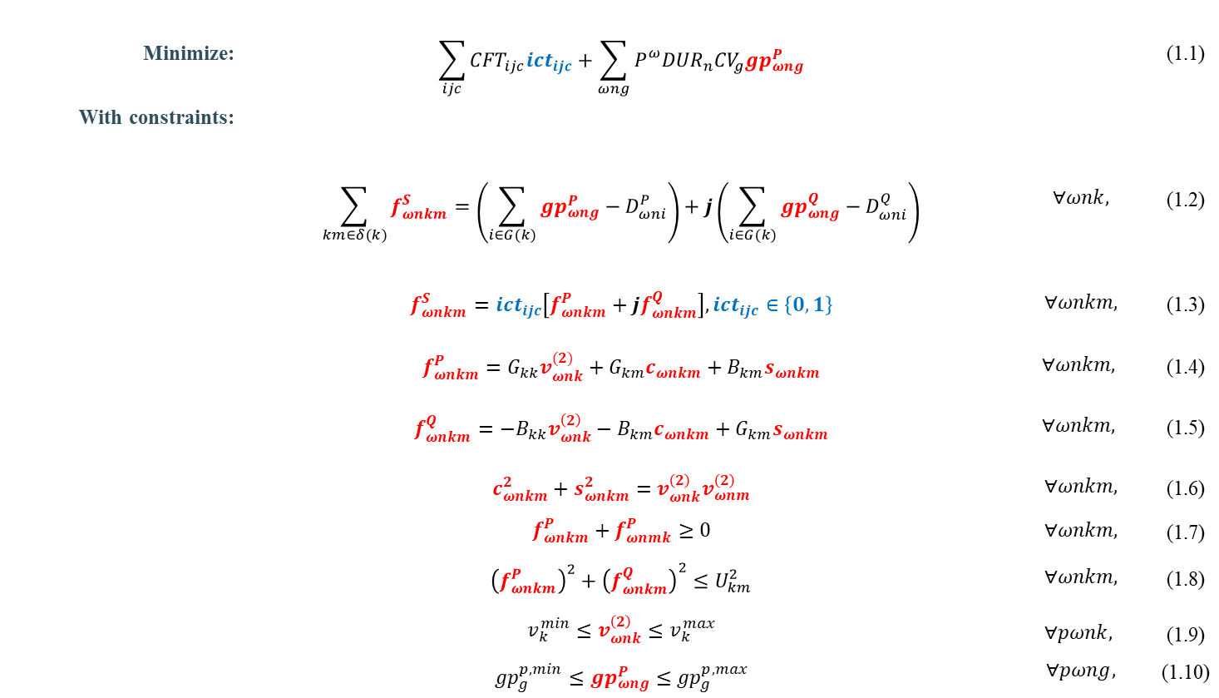
ESOM: Transmission Expansion Planning considering AC-OPF
Minimize: | $$\sum_{ijc}{{CFT}_{ijc}{ict}_{ijc}}+\sum_{ωng}{P_{}^{ω}{DUR}_{n}{CV}_{g}{gp}_{ωng}^{P}}$$ |  | (1.1)
With constraints:
 | $$\sum_{km∈δ(k)}{f_{ωnkm}^{S}}=\left(\sum_{i∈G(k)}{{gp}_{ωng}^{P}−D_{ωni}^{P}}\right)+j\left(\sum_{i∈G(k)}{{gp}_{ωng}^{Q}−D_{ωni}^{Q}}\right)$$ | $$∀ωnk,$$ | (1.2)
 | $$f_{ωnkm}^{S}={ict}_{ijc}\left[f_{ωnkm}^{P}+jf_{ωnkm}^{Q}\right],{ict}_{ijc}∈\left\{0,1\right\}$$ | $$∀ωnkm,$$ | (1.3)
 | $$f_{ωnkm}^{P}=G_{kk}v_{ωnk}^{(2)}+G_{km}c_{ωnkm}+B_{km}s_{ωnkm}$$ | $$∀ωnkm,$$ | (1.4)
 | $$f_{ωnkm}^{Q}=−B_{kk}v_{ωnk}^{\left(2\right)}−B_{km}c_{ωnkm}+G_{km}s_{ωnkm}$$ | $$∀ωnkm,$$ | (1.5)
 | $$c_{ωnkm}^{2}+s_{ωnkm}^{2}=v_{ωnk}^{\left(2\right)}v_{ωnm}^{\left(2\right)}$$ | $$∀ωnkm,$$ | (1.6)
 | $$f_{ωnkm}^{P}+f_{ωnmk}^{P}≥0$$ | $$∀ωnkm,$$ | (1.7)
 | $${\left(f_{ωnkm}^{P}\right)}^{2}+{\left(f_{ωnkm}^{Q}\right)}^{2}≤U_{km}^{2}$$ | $$∀ωnkm,$$ | (1.8)
 | $$v_{k}^{min}≤v_{ωnk}^{\left(2\right)}≤v_{k}^{max}$$ $${gp}_{g}^{p,min}≤{gp}_{ωng}^{P}≤{gp}_{g}^{p,max}$$ | $$∀pωnk,$$ $$∀pωng,$$ | (1.9) (1.10)
Non-convex
Getting a MILP model by applying:
Disjunctive constraints
Piecewise functions
McCormick envelopes

Slide 8
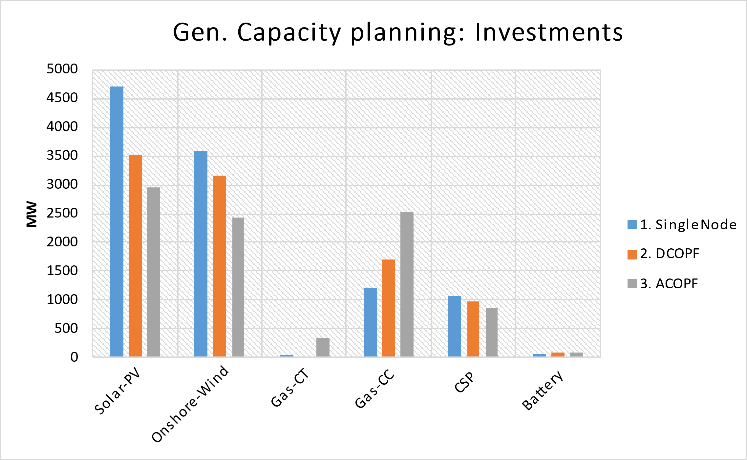
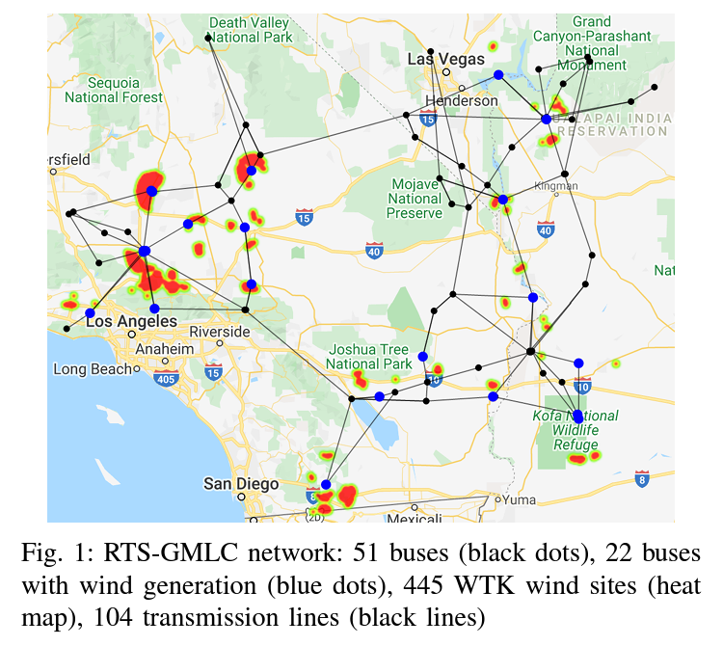
ESOM: Why considering AC-OPF?
Disadvantages:
ACOPF’s problem size is ~4x-6x of the DCOPF
Computation burden: ~6x-10x
Implications on the Gen. capacity planning
Implications on the transmission expansion
RTS-GMLC
Source: Scenario Creation and Power Conditioning Strategies for
Operating Power Grids with Two-Stage Stochastic Economic Dispatch
Link: https://www.nrel.gov/docs/fy21osti/75363.pdf

Slide 9
Neural Network for cost estimation
Goal
Estimate the hourly operational cost of the OPF problem
Sensitive to
time-series changes
physical network changes
Approach
Neural network works on hourly basis → Estimates one cost value
Single output (cost)
Input contains
Demand (per node)
Renewable availability factors (per technology per location)
Admittance matrix
Size of input vector quickly grows with number of buses
Demands
Availabilities
Admittance matrix
Input layer
…
…
…
Hidden layer
…
Single output
Operational cost for one hour

Slide 10
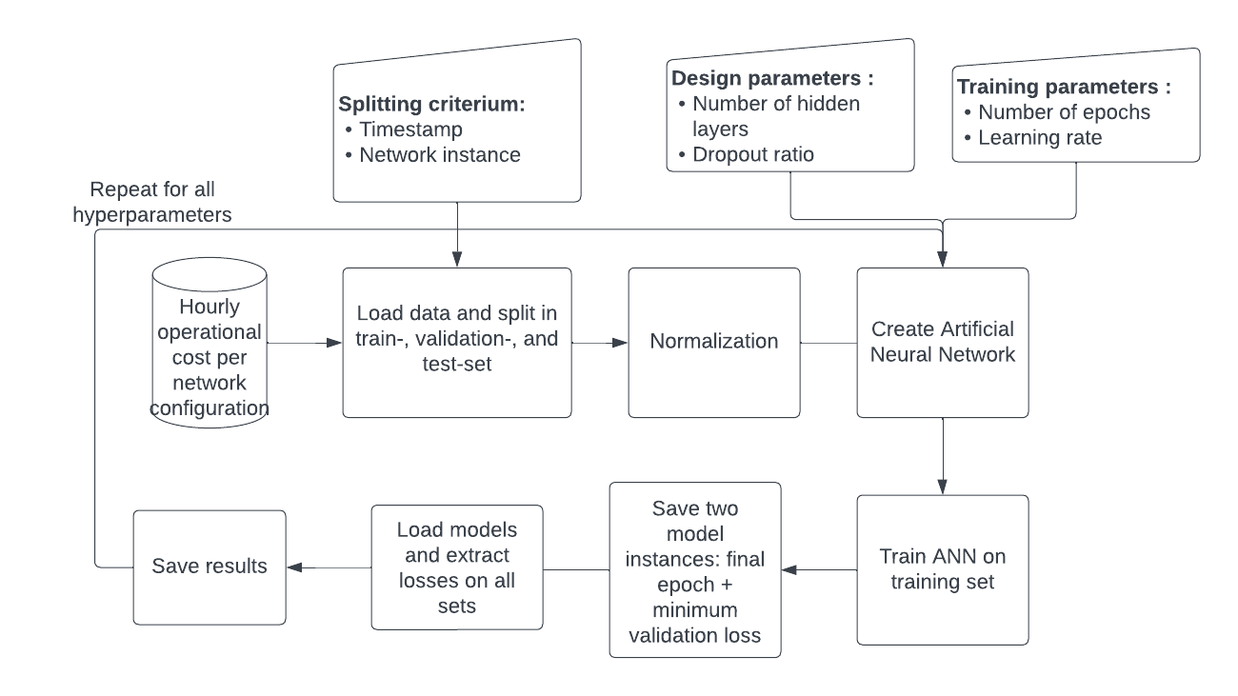
Neural network training
Goal
Train and test on a subset of desired outcomes
Achieve speedup by obtaining remaining outcomes with NN instead of optimization
Approach
Optimization performed for
1 week of each month
All individual line candidates
Split obtained dataset into training and test sets
Tune network design to obtain best result on test set

Slide 11
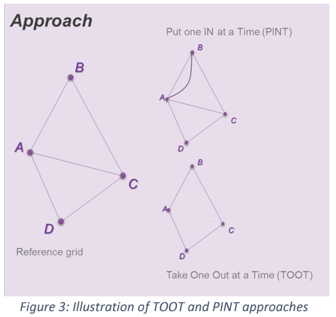
Line Benefits
The PINT and TOOT
Investment Benefit
ANN: Cost Estimator
Sequence per candidate asset and hour
PINT (or TOOT)
Reference grid
ANN Cost
Estimator
ANN Cost
Estimator
Line Benefit Methods:
The Put IN one at the Time (PINT)
The Take Out One at the Time (TOOT)
Shapley value
Aumann-shapley value
Benefit 1 (Benefit 2) =
Reference grid – PINT
(TOOT – Reference grid)
[source] ENTSO-E: Guideline for Cost Benefit Analysis of Grid Development Projects
Link: https://eepublicdownloads.entsoe.eu/clean-documents/tyndp-documents/Cost%20Benefit%20Analysis/191023_CBA3_Draft%20for%20consultation.pdf
Disadvantages of the PINT:
Computationally expensive
>~15 hours for all the process in the RTS24

Slide 12
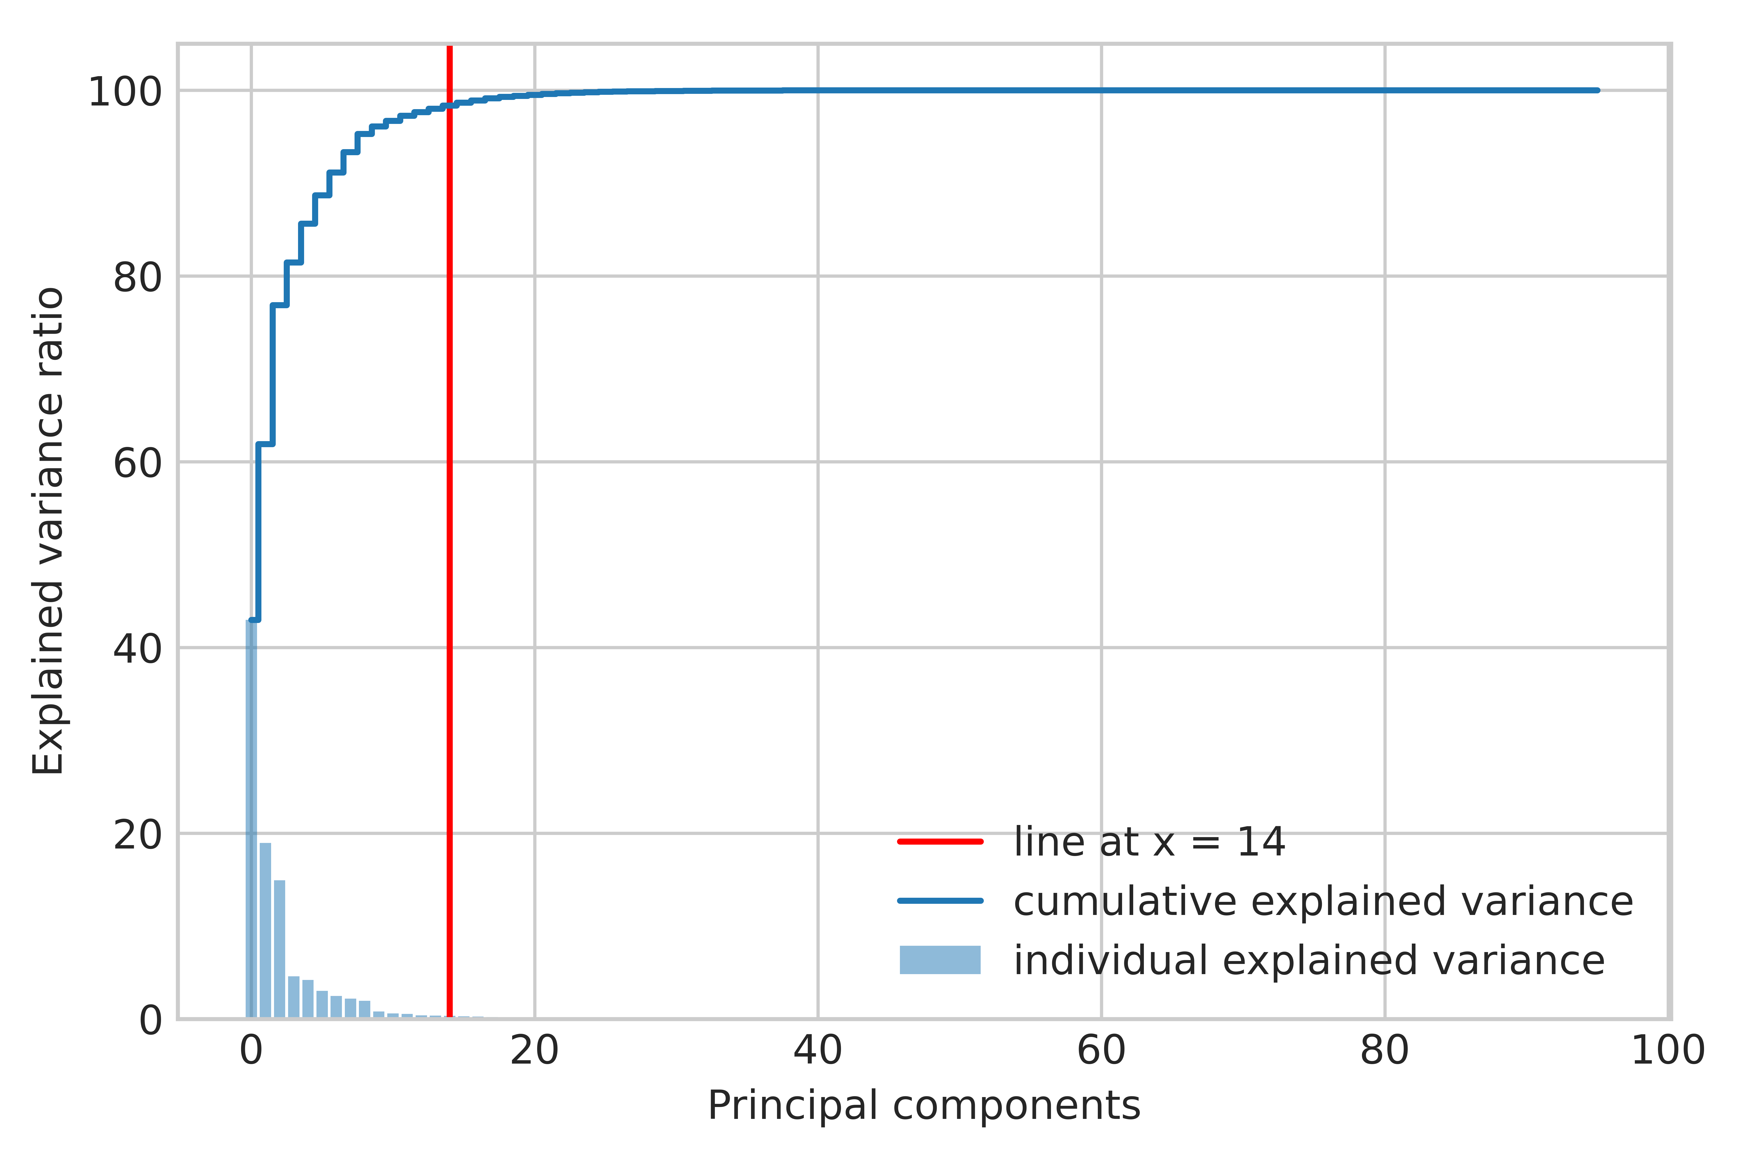
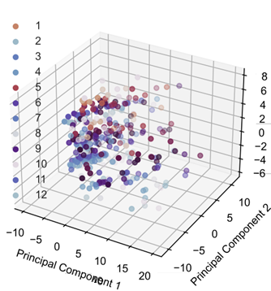
Clustering process
Dimensionality reduction
Optimal number of representatives/clusters
Selection/aggregation using K-medoids
Dimensionality reduction using PCA
Optimal number of clusters:
Elbow method

Slide 13
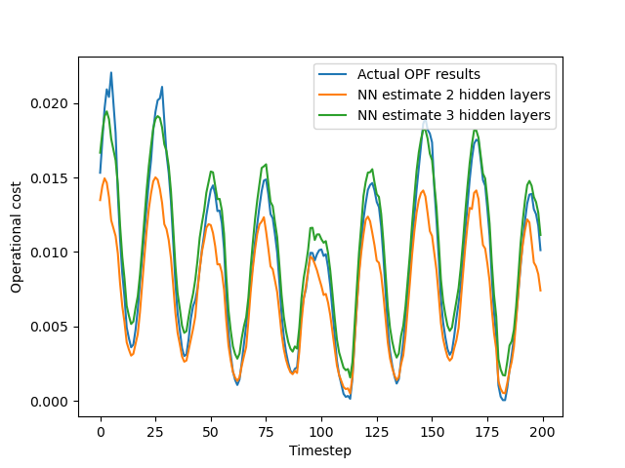
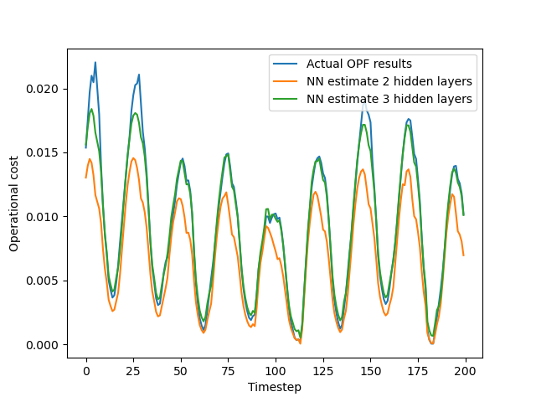
NN estimates: preliminary results
Training set
Estimation of operational cost for 24 bus system
Time dependency is reproduced, but predictions are not perfect
More complex networks (more hidden layers) seem to be performing better
Test set

Slide 14
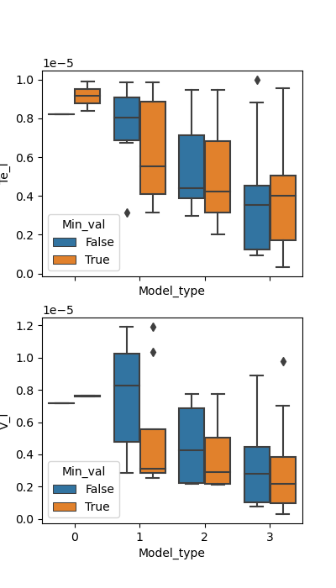
NN estimates: hyperparameter tuning
Goal
Find the optimal design and training parameters for the neural network
Approach
Train a bunch of models on the same dataset and store the loss (MSE) on the test set for all of them
Continue with model that has lowest loss
Problem
There seems to be quite some randomness

Slide 15
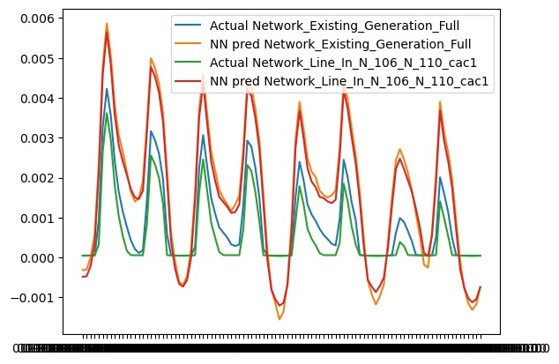
NN estimates: towards line benefits
Eventually, line benefits obtained from NN must match actual line benefits
Differences between costs from different physical networks are quite small → Predictions must be extremely accurate?
Maybe not, as long as differences are well-reproduced
→ Estimate line benefits directly?

Slide 16
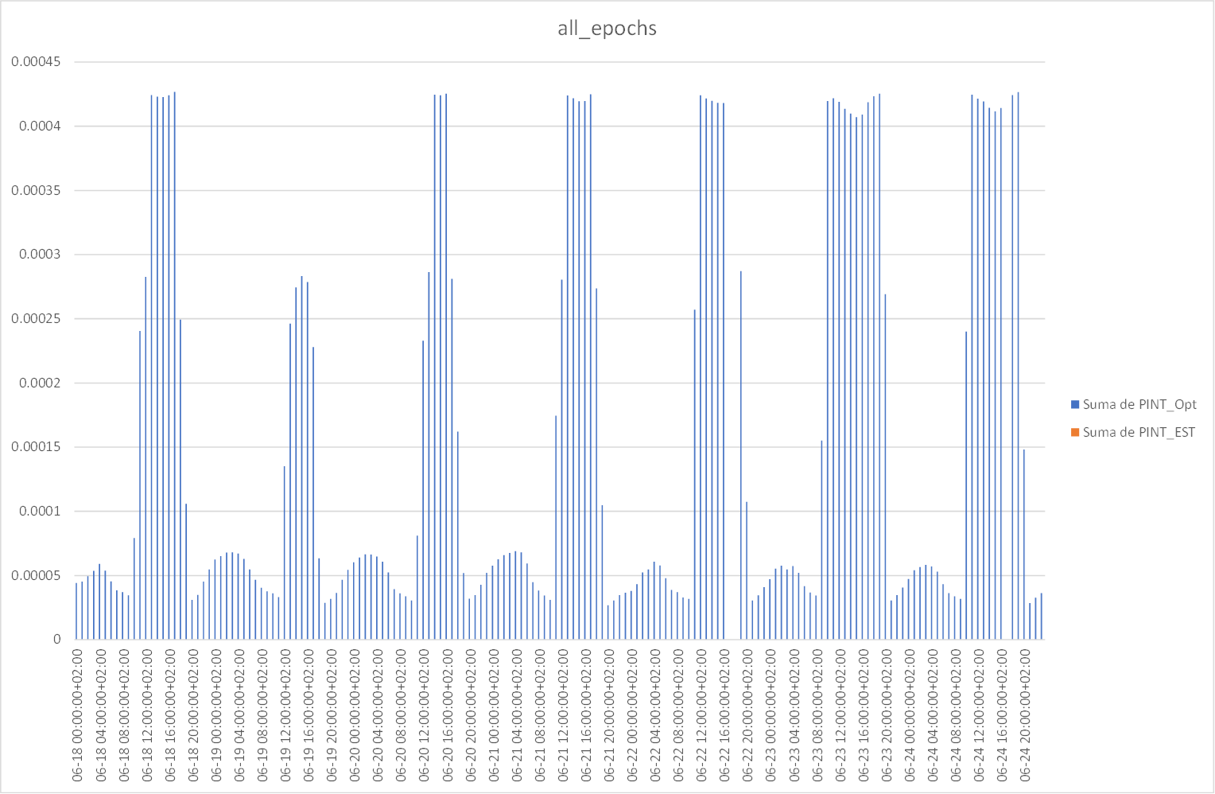
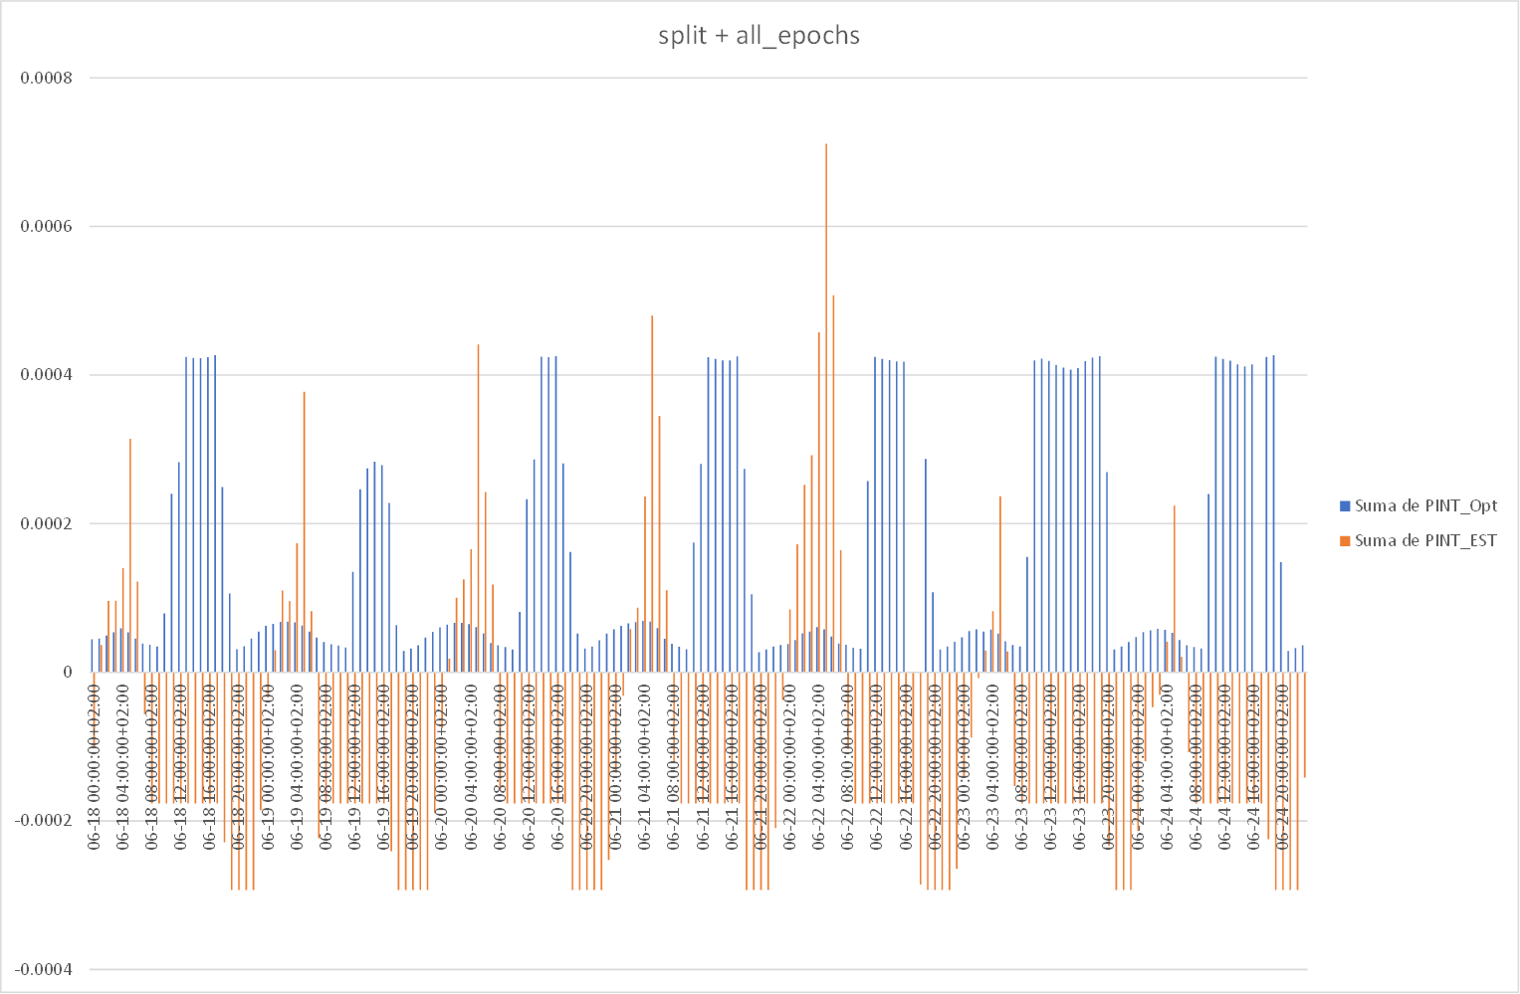
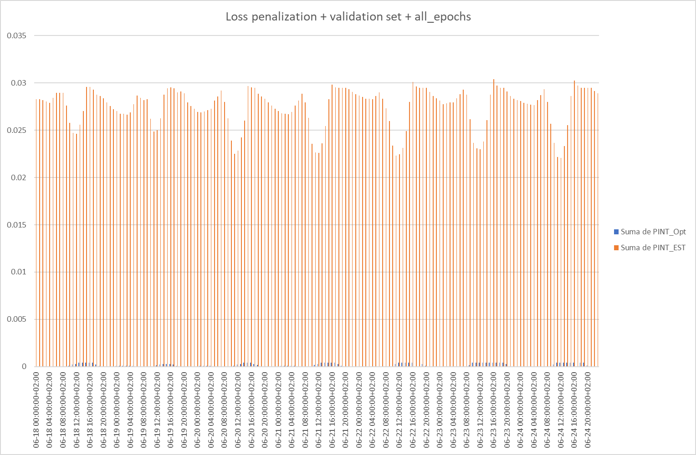
Line Benefits: Preliminary results for the PINT method
Using our first ANN
Including the validation set
Including the penalization
Advantage:
Less computation time: ~2 hour instead of >~30 hours for the benefits of 39 candidate lines in the RTS24 (considering 8736 hours)

Slide 17
Future tasks
Consider more complex networks: more hidden layers
Use physics-informed loss function: prevent negative costs (WIP)
Extending or changing the used data:
More input hours/line expansions
Consider other outputs than operational costs
Line utilization
Marginal costs
Estimate line benefits directly instead of operational costs

